Slide 1


Predicting Postnatal Depression During the COVID-19 Pandemic: A Data Mining Approach
Presenter name
University of Colorado Boulder
DATA SCIENCE

Slide 2
Abstract
This project aims to develop a predictive model for identifying individuals at high risk of postnatal depression using data collected during the COVID-19 pandemic, highlighting the use of data mining techniques and the potential impact on healthcare interventions.
DATA SCIENCE

Slide 3
Introduction
The COVID-19 pandemic has heightened anxiety and stress among pregnant individuals, leading to increased mental health challenges due to social isolation and healthcare disruptions.
Early detection of postnatal depression is vital for the health of both mothers and infants. Timely intervention can prevent long-term psychological issues and improve overall outcomes.
Objectives:
Develop a predictive model for postnatal depression.
Identify key predictors from demographic, mental health, and perceived threat data.
Support healthcare interventions by providing actionable insights.
Enhance maternal and infant health through early detection and support.
DATA SCIENCE

Slide 4
Problem Statement
Increased Stress During Pregnancy Due to COVID-19:
The pandemic has significantly elevated stress levels in pregnant individuals, contributing to mental health challenges.
Goal of Predicting Postnatal Depression:
Develop a model to predict postnatal depression using the Edinburgh Postnatal Depression Scale (EPDS), incorporating pandemic-specific stress factors.
Importance of Early Identification:
Early identification of at-risk individuals is crucial for timely intervention, reducing the risk of long-term mental health issues for both mothers and infants.
DATA SCIENCE

Slide 5
Proposed Work
Data Cleaning: Handling missing values and converting categorical variables.
EDA: Visualizing data relationships and identifying correlations.
Feature Engineering: Selecting relevant features.
Modeling: Training and evaluating regression models.
Evaluation: Using MSE and R² metrics.
Feature Importance: Identifying key features using the Random Forest model.
DATA SCIENCE

Slide 6
Evaluation Plan
Metrics for assessing model performance: MSE and R².
Criteria for success: low MSE, high R², and actionable insights.
Importance of feature importance analysis for refining the model.
DATA SCIENCE

Slide 7
Timeline
Week 3: Data Cleaning and Preparation
Week 4: Exploratory Data Analysis and Feature Engineering
Week 5: Model Training and Initial Evaluation
Week 6: Model Refinement and Feature Importance Analysis
Week 7: Final Evaluation and Report Preparation
DATA SCIENCE

Slide 8
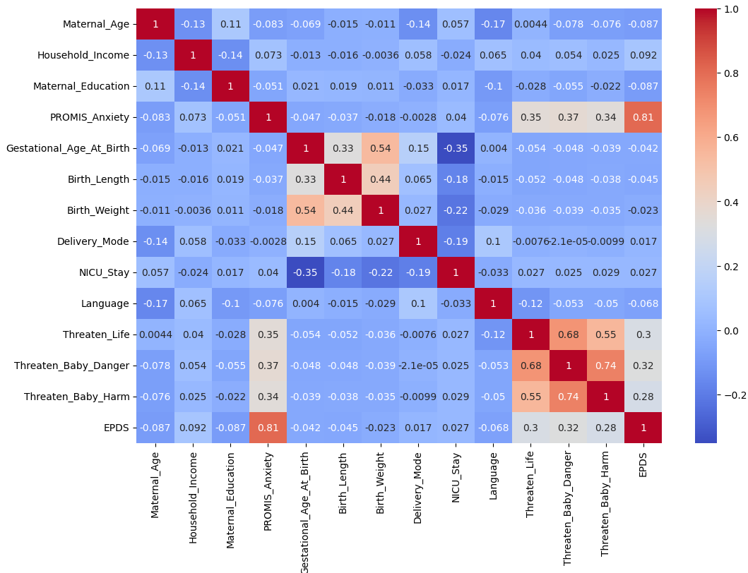
Progress So Far
Completed data cleaning and preprocessing.
Performed exploratory data analysis (EDA) and visualized relationships.
Trained and evaluated Linear Regression and Random Forest models.
Assessed model performance using MSE and R².
DATA SCIENCE

Slide 9
Changes Made
Updated feature selection based on initial findings from EDA.
Improved data preprocessing steps to handle missing values more effectively.
Enhanced model evaluation metrics to better capture performance.
DATA SCIENCE

Slide 10
References
Gao, W., Jalal, Z., Taylor, B. K., Qian, H., Reichert, A. R., & Blank, P. R. (2023). The impact of COVID-19 pandemic on mental health in pregnant individuals. The Lancet Regional Health – Europe, 24. https://doi.org/10.1016/j.lanepe.2023.100473
Huang, Y., Alvernaz, S., Kim, S. J., Maki, P., Dai, Y., & Peñalver Bernabé, B. (2023). Predicting prenatal depression and assessing model bias using machine learning models. medRxiv. https://doi.org/10.1101/2023.07.17.23292587
DATA SCIENCE

